Slide 1

Interpretable ai
Dr. Sanket Mishra, SCOPE

Slide 2
Motivation
We have a match “Uruguay vs Russia,” and we want to know how much the prediction for “Player of The Match” prize that resulted from the ML model has been driven by the number of goals scored by Uruguay. We compare the prediction to a baseline value that is defined as the average value for all the predictions of all the matches.

Slide 3
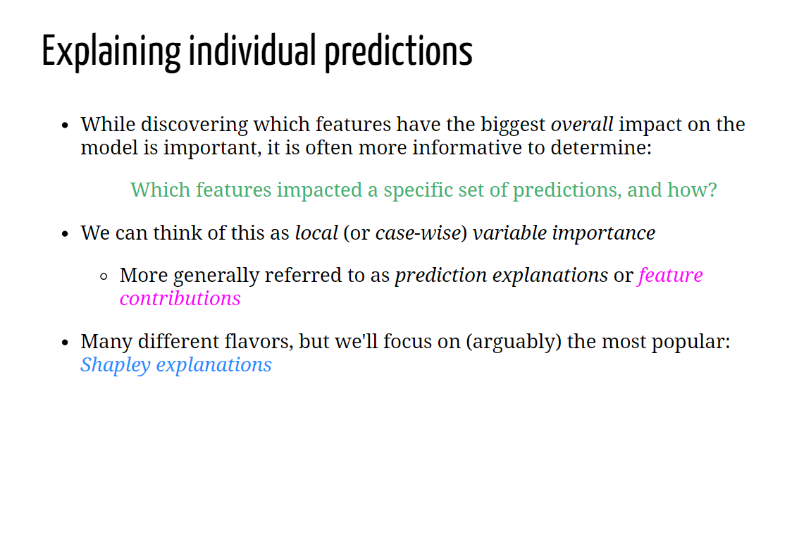

Slide 4
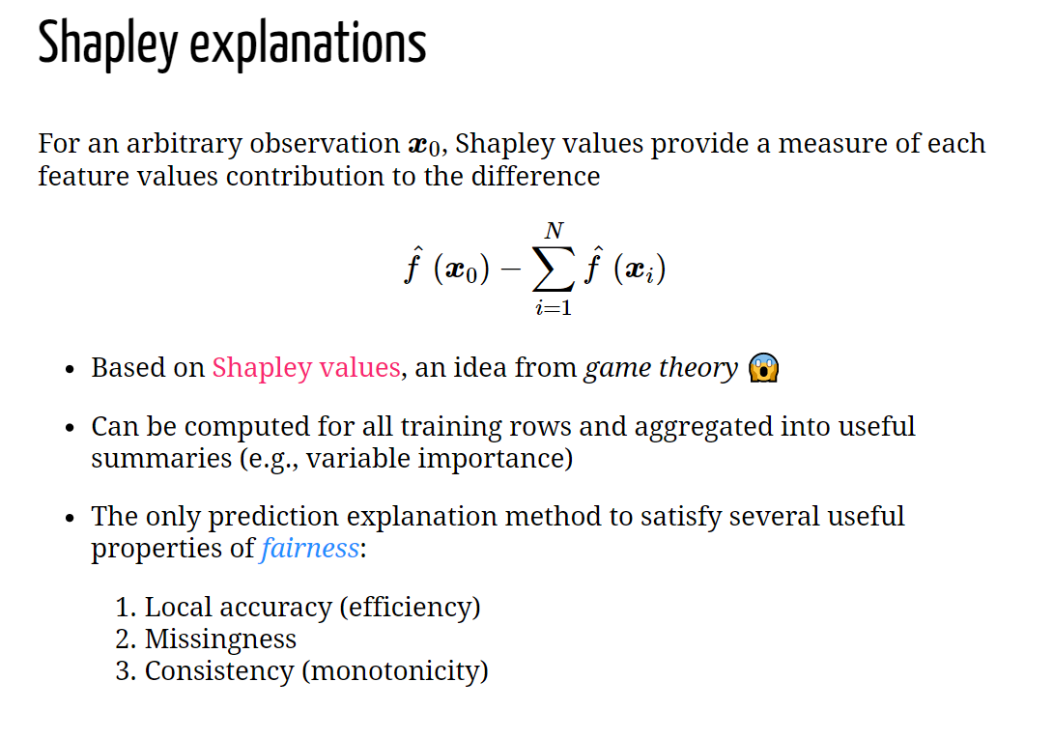

Slide 5
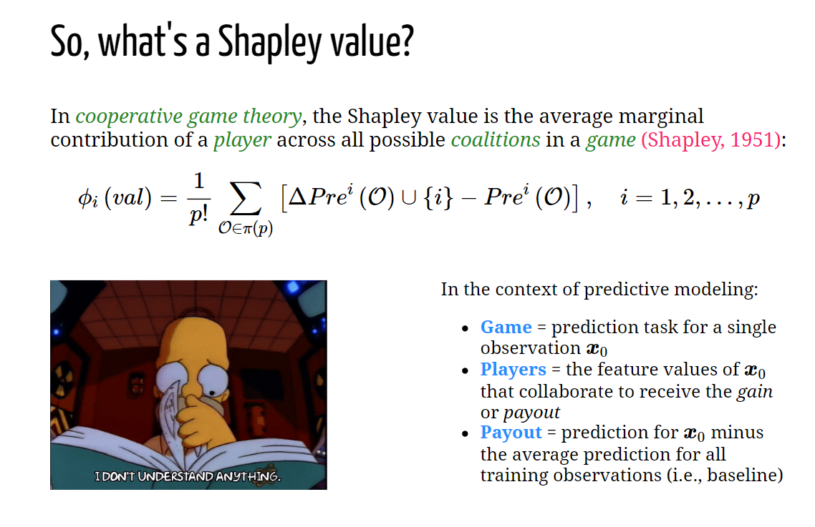

Slide 7
lime
Let’s say our built model is in the form y = f(x).
An agnostic explainer works with models that are of the black-box type. So without any knowledge of the inner workings of the model f, the explainer builds an
explaining model g having access only to the outputs of model f and possibly some
info on the training set or the domain.

Slide 8
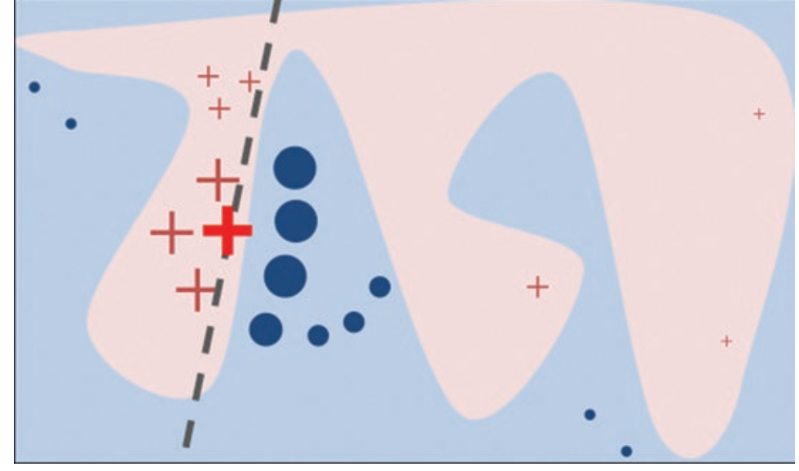
lime

Slide 9
Working
The aim is to probe the model as often as needed to interpret how the model comes up with the prediction for that picked example.
You can probe the model by perturbing the dataset to get the model predictions for that new dataset

Slide 10
Creation of perturbed data
Given the training data, calculate the key summary statistics for each feature. For numerical or continuous features, calculate the mean and standard deviation.
For categorical features, compute the frequency of each value. Then create a new dataset by sampling based on these summary statistics. For numerical features, data is sampled from a Gaussian distribution given the mean and standard deviation for that feature.
For categorical features, sample based on the frequency distribution or probability mass function. Once you’ve created this dataset, probe the model by getting predictions for them.

Slide 11
Creation of perturbed data
Once you have created the perturbed dataset and obtained the model predictions for them, weight these new samples by their proximity to the picked instance.
This is done to interpret the picked instance by looking at cases similar to it in terms of features. The locality of the interpretation is captured by this weighting. Hence, the “local” in the acronym LIME.

